Slide 1
Database Design and Implementation
Lecture 4
Conceptual Database Design

Slide 2
Learning Outcomes
In this Lecture, students will learn:
  How to use Entity–Relationship (ER) modeling to build a conceptual data model based on the data requirements of an enterprise.
  How to validate the resultant conceptual model to ensure it is a true and accurate representation of the data requirements of an enterprise.
  How to document the process of conceptual database design.
  How the end-users play an integral role throughout the process of conceptual database design.

Slide 3
Agenda
This Lecture will cover:
  Conceptual Database Design
  Critical Success Factors in Database Design
  Database Design Methodology
  Build Conceptual Data Model
Notes:
NCC Education - Slide Master

Slide 4
Conceptual Database Design
The process of constructing a model of the data used in an enterprise, independent of all physical considerations.

Slide 5
Critical Success Factors in Database Design
Work interactively with the users as much as possible.
Follow a structured methodology throughout the data modelling process.
Employ a data-driven approach.
Incorporate structural and integrity considerations into the data models.
Combine conceptualization, normalization, and transaction validation techniques into the data modelling methodology.

Slide 6
Critical Success Factors in Database Design
Use diagrams to represent as much of the data models as possible.
Use a Database Design Language (DBDL) to represent additional data semantics.
Build a data dictionary to supplement the data model diagrams.
Be willing to repeat steps.

Slide 7
Database Design Methodology
Conceptual database design
Step 1 Build conceptual data model
  Step 1.1 Identify entity types
  Step 1.2 Identify relationship types
  Step 1.3 Identify and associate attributes with entity or relationship types
  Step 1.4 Determine attribute domains
  Step 1.5 Determine candidate, primary, and alternate key attributes
  Step 1.6 Consider use of enhanced modeling concepts (optional step)
  Step 1.7 Check model for redundancy
  Step 1.8 Validate conceptual model against user transactions
  Step 1.9 Review conceptual data model with user

Slide 8
Database Design Methodology
Logical database design
Step 2 Build and validate logical data model
  Step 2.1 Derive relations for logical data model
  Step 2.2 Validate relations using normalization
  Step 2.3 Validate relations against user transactions
  Step 2.4 Define integrity constraints
  Step 2.5 Review logical data model with user
  Step 2.6 Check for future growth

Slide 9
Database Design Methodology
Physical Database Design
Step 3 Translate logical data model for target DBMS
  Step 3.1 Design base relations
  Step 3.2 Design representation of derived data
  Step 3.3 Design general constraints
Step 4 Design file organizations and indexes
  Step 4.1 Analyse transactions
  Step 4.2 Choose file organization
  Step 4.3 Choose indexes
  Step 4.4 Estimate disk space requirements
Step 5 Design user views
Step 6 Design security mechanisms
Step 7 Consider the introduction of controlled redundancy
Step 8 Monitor and tune the operational system

Slide 10
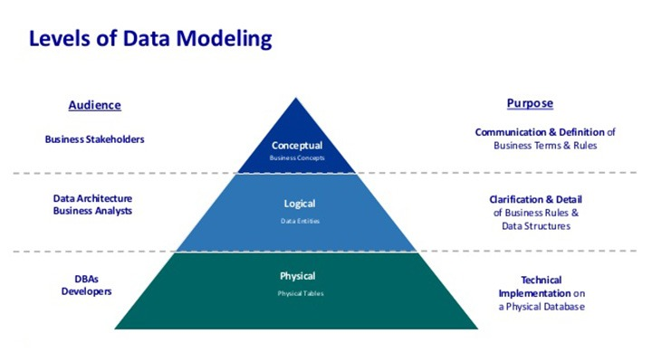

Slide 11
First of all, Lets look at the Conceptual Design Methodology in detail in this slide.
Further, we will look at Logical and Physical Design Methodology in Lecture slide 5 and 6 respectively.

Slide 12
Step 1 Build Conceptual Data Model
To build a conceptual data model of the data requirements of the enterprise.
  Model comprises entity types, relationship types, attributes and attribute domains, primary and alternate keys, and integrity constraints.
Step 1.1 Identify entity types
  To identify the required entity types.
Step 1.2 Identify relationship types
  To identify the important relationships that exist between the entity types.

Slide 13
Step 1.3 Identify and associate attributes with entity or relationship types
  To associate attributes with the appropriate entity or relationship types and document the details of each attribute.
Step 1.4 Determine attribute domains
  To determine domains for the attributes in the data model and document the details of each domain.

Slide 14
Step 1.5 Determine candidate, primary, and alternate key attributes
  To identify the candidate key(s) for each entity and if there is more than one candidate key, to choose one to be the primary key and the others as alternate keys.
Step 1.6 Consider use of enhanced modeling concepts (optional step)
  To consider the use of enhanced modeling concepts, such as specialization / generalization, aggregation, and composition.

Slide 15
Step 1.7 Check model for redundancy
  To check for the presence of any redundancy in the model and to remove any that does exist.
Step 1.8 Validate conceptual model against user transactions
  To ensure that the conceptual model supports the required transactions.
Step1.9 Review conceptual data model with user
  To review the conceptual data model with the user to ensure that the model is a ‘true’ representation of the data requirements of the enterprise.

Slide 16
References
Database Systems A Practical Approach to Design, Implementation and Management by Thomas Connolly and Carolyn Begg, Sixth Edition, Pearson, Chapter 16

